Slide 1
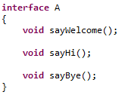
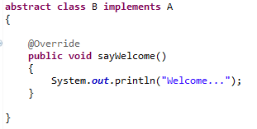
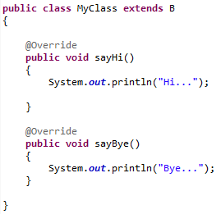
Abstract class in Java
implements
extends
The abstract class can also be used to provide some implementation of the interface. In such case, the end
user may not be forced to override all the methods of the interface.

